Slide 1


Application of graph theory in switching and coding theorem
ASSIGNMENT-3
PRESENTED BY Madhurima Rawat ROLL NO-$300012821042$ DATASCIENCE(CSE)
Chhattisgarh Swami
Vivekananda Technical
University

Slide 2
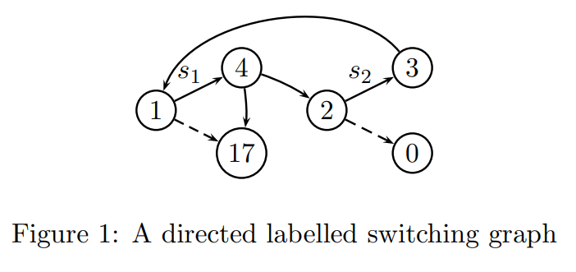
In switching
Switching graphs are graphs containing switches. By using boolean functions called switch settings,
These switches can be put in a fixed
direction to obtain an ordinary graph.
For many problems, switching
graphs are a remarkable straightforward and natural model

Slide 3
Application of graph theory
We started investigating switching graphs because they
Turned out to be a natural framework for studying the problem of solving boolean equation systems,
Which is equivalent to model checking of the modal μ-calculus and deciding the winner in parity Games.
We give direct, polynomial encodings of boolean equation systems in switching graphs and
Vice versa, and prove correctness of the encodings.

Slide 4
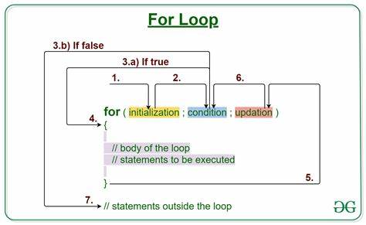
Problem switching
The loop problem the loop problem is the question whether there is a switch setting f such that G contains an f-loop.
Theorem :-The loop problem is solvable in
quadratic time.
Proof. This problem is equivalent to the
v-v-connection problem for
every vertex v. If for some vertex v a switch setting f is found such
that v is connected to itself, then the answer is yes. Otherwise, the answer is no.

Slide 5
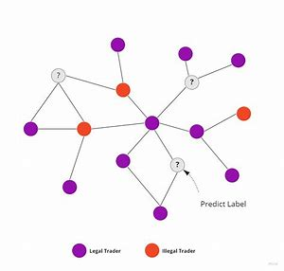
In coding theorem
Modelling of complex networks, like social networks or in the simulation of a disease like the new coronavirus. Each node can represent one person or a population, and edges can represent probability/easiness of transmission. In this model,
we can try to identify or form circular, closed graphs.
Organization and anything hierarchical. Graphs don’t have to be
loopy and cyclical; they can also express a hierarchy. For instance,
if you were to create an API for a local library to access books by
various content, you’d want to create a graph. If you wanted to
create a site map for your website, you’d use a graph.

Slide 6
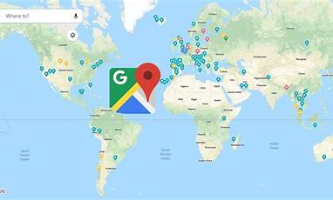
practical applications
Any problem that involves an agent travelling between many locations or states is most likely represented well with a graph. Using graphs can help reduce the complexity of almost any programming problem.
A service like google maps, which tells you the best route to
take, considering not only distance but traffic time, elevation,
tolls, etc. It is, essentially, finding the best path in a massive
weighted graph (imagine a node every few feet or so, and a
graph spanning the earth).

Slide 7
Coding implementation in python
# Python program for
# validation of a graph
# import dictionary for graph
from collections import defaultdict
# function for adding edge to graph
graph = defaultdict(list)
def addEdge(graph,u,v):
graph[u].append(v)
# definition of function
def generate_edges(graph):
edges = []
# for each node in graph
for node in graph:
# for each neighbour node of a single node
for neighbour in graph[node]:
# if edge exists then append
edges.append((node, neighbour))
return edges
# declaration of graph as dictionary
addEdge(graph,'a','c')
addEdge(graph,'b','c')
addEdge(graph,'b','e')
addEdge(graph,'c','d')
addEdge(graph,'c','e')
addEdge(graph,'c','a')
addEdge(graph,'c','b')
addEdge(graph,'e','b')
addEdge(graph,'d','c')
addEdge(graph,'e','c')
# Driver Function call
# to print generated graph
print(generate_edges(graph))

Slide 8
output
[('a', 'c'), ('b', 'c'), ('b', 'e'), ('c', 'd'), ('c', 'e'), ('c', 'a'), ('c', 'b'), ('e', 'b'), ('e', 'c'), ('d', 'c’)]
As we have taken example of undirected graph, so we have print same edge twice say as (‘a’,’c’) and (‘c’,’a’). We can overcome this with use of directed graph.

Slide 9
Coding implementation in python
# Python program to generate the first
# path of the graph from the nodes provided
graph = {
'a': ['c'],
'b': ['d'],
'c': ['e'],
'd': ['a', 'd'],
'e': ['b', 'c']
# function to find path
def find_path(graph, start, end, path=[]):
path = path + [start]
if start == end:
return path
for node in graph[start]:
if node not in path:
newpath = find_path(graph, node, end, path)
if newpath:
return newpath
# Driver function call to print the path
print(find_path(graph, 'd', 'c'))
OUTPUT
['d', 'a', 'c']

Slide 10
THANK YOU FOR LISTENING TO MY PRESENTATION
ANY QUESTIONS

